Slide 1
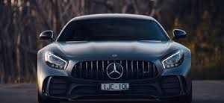
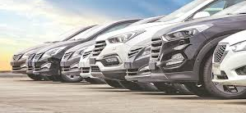
Car Insurance Claim Prediction Using XGBoost
A Machine Learning Approach for Risk Assessment
By 2210080013_Abhay
2210080028_Saicharan
2210080039_Abhinav
2210080069_SatyaLokesh

Slide 2

Problem Statement
Rising fraudulent claims lead to significant financial losses for insurance companies.
Traditional claim assessment methods rely on manual verification, which is time-consuming and less effective.
Challenges faced:
Difficulty in detecting fraudulent claims early.
High volume of claims makes manual processing inefficient.
Risk of incorrect claim approvals or rejections.
Need for a solution:
A machine learning-based approach can automate and enhance claim prediction accuracy.
XGBoost offers superior performance in identifying potential fraud and optimizing risk assessment.

Slide 3
Introduction
What is Car Insurance Claim Prediction?
A process of estimating whether an insurance policyholder will file a claim based on historical data.
Helps insurers make informed decisions about risk assessment and fraud detection.
Importance:
Reduces financial losses due to fraudulent or unnecessary claims.
Helps insurers assess risk and optimize premium pricing.
Improves customer satisfaction by streamlining the claim approval process.
Role of Machine Learning (ML):
Automates claim assessment and fraud detection.
Identifies complex patterns in data that traditional methods might miss.
Improves prediction accuracy and decision-making.

Slide 4
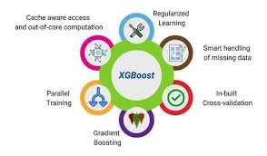
Extreme Gradient Boosting (XGBoost):
Extreme Gradient Boosting (XGBoost):
A powerful and optimized machine learning algorithm based on gradient boosting.
Widely used for structured and tabular data in classification and regression tasks.
Why XGBoost?
Efficient for Large Datasets: Handles millions of records with optimized computation.
Reduces Overfitting: Implements regularization techniques (L1 & L2) to prevent model complexity.
Improves Accuracy: Uses boosting techniques to enhance prediction performance.
Handles Missing Values: Automatically manages missing data, making preprocessing easier.

Slide 5
Why XGBoost and Dataset Used?
Why XGBoost?
Optimized for performance
Handles missing values efficiently
Strong feature importance ranking
Dataset Used: Kaggle Car Insurance Claim Data
Policy details, vehicle info, driver history, external factors

Slide 6

Data Preprocessing
Handling missing values
Encoding categorical variables
Feature selection & scaling
Data split into training & testing sets

Slide 7
Model Development
Implementing XGBoost classifier
Fine-tuning with hyperparameter optimization
Training vs testing data performance evaluation

Slide 8
Model Evaluation Metrics
Metrics Used:
Confusion Matrix (TP, FP, TN, FN)
Accuracy Score
Precision, Recall & F1-score
ROC-AUC Curve for performance comparison

Slide 9

Results & Analysis
Comparison of XGBoost vs other models
01
Feature importance insights
02
How well it predicts insurance claims
03

Slide 10
Applications in the Insurance Industry
Fraud Detection & Risk Assessment
Identifies fraudulent claims using historical patterns and anomalies.
Helps insurers minimize financial losses by detecting high-risk claims early.
Personalized Premium Pricing
Predicts the likelihood of a claim and adjusts premiums accordingly.
Fairer pricing for customers based on their risk profile.
Customer Segmentation Based on Risk
Groups policyholders into different risk categories.
Allows insurers to tailor policies, offers, and services based on risk levels.

Slide 11

Conclusion & Future Scope
Conclusion:
XGBoost enhances claim prediction accuracy, making risk assessment more reliable.
Helps insurers minimize losses by detecting fraudulent claims early.
Improves operational efficiency by automating claim approvals and risk evaluation.
Future Enhancements:
Deep Learning Integration: Advanced neural networks for improved pattern recognition.
Use of Real-Time Telematics Data: Leverage vehicle sensors and driving behavior data for dynamic risk assessment.
AI-Driven Fraud Detection: Implement AI models that continuously learn from new fraud patterns to improve detection rates.

Slide 12

Thank you

